Slide 1
BASIC CONCEPT OF GRAPH

Slide 2
INTRODUCTION TO GRAPHS THEORY
Graph theory plays an important role in several areas of computer
science such as:
• switching theory and logical design
• artificial intelligence
• formal languages
• computer graphics
• operating systems
• compiler writing
• information organization and retrieval.

Slide 3
GRAPH
A graph is a non-empty set of points called vertices and a set of line segments joining
pairs of vertices called edges.
Formally, a graph G consists of two finite sets:
(i) A set V=V(G) of vertices (or points or nodes)
(ii)A set E=E(G) of edges; where each edge corresponds to a pair of vertices.

Slide 4
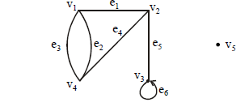
CONT…
The graph G with
V(G) = {v1, v2, v3, v4, v5} and
E(G) = {e1, e2, e3, e4, e5, e6}

Slide 5
SOME TERMINOLOGY:
1. An edge connects either one or two vertices called its endpoints (edge e1 connects
vertices v1 and v2 described as {v1, v2} i.e v1 and v2 are the endpoints of an edge e1).
2. An edge with just one endpoint is called a loop. Thus a loop is an edge that connects a
vertex to itself (e.g., edge e6 makes a loop as it has only one endpoint v3).
3. Two vertices that are connected by an edge are called adjacent; and a vertex that is
an endpoint of a loop is said to be adjacent to itself.
4. An edge is said to be incident on each of its endpoints(i.e. e1 is incident on v1 and v2 ).
5. A vertex on which no edges are incident is called isolated (e.g., v5)
6. Two distinct edges with the same set of end points are said to be parallel (i.e. e2 & e3).

Slide 6
BASIC TERMINOLOGY
1. TRIVIAL GRAPH
A Graph consisting one vertex and no edge.
2. NULL GRAPH
A graph consisting n vertices and no edge.
3. DIRECTED GRAPH
A graph consist the direction of edges then this is called directed graph.
4. UNDIRE TED GRAPH
A graph which is not directed.

Slide 7
CONT…
5. SELF LOOP IN GRAPH
If edge having same vertex as both its end vertices is called self loop.
6. PROPER EDGE
An edge which is not self loop is called proper edge
7. MULTI EDGE
A collection of two or more edges having identically end point.
8. SIMPLE GRAPH
A graph does not contain any self loop and multiedge.

Slide 8
CONT…
9.MULTI GRAPH
A graph does not include any self loop but contain multi edge is called multi graph.
10. PSEUDO GRAPH
A graph contain both self loop and multi edge is called pseudo graph
11. INCIDENCE AND ADJACENCY
Let ek be an edge joining two vertices Vi, Vj then ek is said to be incident of Vi and Vj, two vertices as said to be adjacent if there exist an edge joining this vertices.

Slide 9
CONT…
12. DEGREE OF VERTEX
The degree of vertex V in a graph G written as d(V) is equal to number of edges which are incident on V with self loop count twice.
ISOLATED VERTEX AND PENDANT VERTEX
A vertex having 0 is called isolated vertex and vertex having degree 1 is called pendant graph.
14. FINITE AND INFINITE GRAPH
A graph with finite number of vertices as well as edges is called finite graph otherwise it is called an infinite graph.

Slide 10
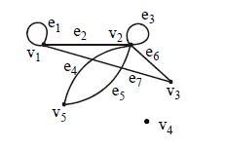
EXAMPLE:
For the graph shown below
(i) find all edges that are incident on v1;
(ii)find all vertices that are adjacent to v3;
(iii)find all loops;
(iv)find all parallel edges;
(v)find all isolated vertices;

Slide 11
SOLUTION:
(i) v1 is incident with edges e1, e2 and e7
(ii) vertices adjacent to v3 are v1 and v2
(iii) loops are e1 and e3
(iv) only edges e4 and e5 are parallel
(v) The only isolated vertex is v4 in this Graph.

Slide 12
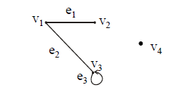
EXAMPLE:
Define the following graph formally by specifying its vertex set, its edge set,
and a table giving the edge endpoint function.

Slide 13
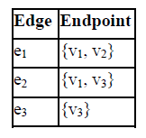
SOLUTION:
Vertex Set = {v1, v2, v3, v4}
Edge Set = {e1, e2, e3}
Edge - endpoint function is:

Slide 14
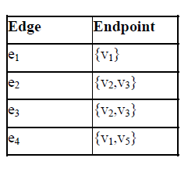
DRAWING PICTURE FOR A GRAPH:
Draw picture of Graph H having vertex set {v1, v2, v3, v4, v5} and edge set {e1, e2, e3, e4}
with edge endpoint function

Slide 15
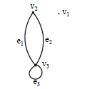
EXAMPLES
1. Draw all simple graphs with the four vertices {u, v, w, x} and two edges,
one of which is {u, v}.
2. Find the degree of graph.

Slide 16
CONT…
3. Suppose a graph has vertices of degrees 1, 1, 4, 4 and 6. How many edges does the graph have?
4. In a group of 15 people, is it possible for each person to have exactly 3 Friends?

